Slide 1
Smart cooker whistle counter with auto shut-off
NAME: TELAPOLU MANI SAI LOKESH
REGNO: 192224105
SUPERVISOR : Dr. Arjun Pandian

Slide 2
Problem statement
Traditional pressure cookers require constant attention to count whistles and manually switch off the heat, which can result in overcooking or burning food. This process is time-consuming and increases the risk of accidents. For individuals with busy schedules, it becomes difficult to monitor cooking while managing other tasks. Therefore, there is a need for a smart cooker that automatically counts whistles and turns off the heat, ensuring precise cooking and enhanced safety.

Slide 3
INTRODUCTION
The Smart Cooker Whistle Counter with Automatic Switch-Off is a modern kitchen innovation that simplifies and improves the cooking process. Pressure cooking, although efficient, is a very demanding process as one has to count whistles and manually switch off the heat, which can result in overcooking or accidents. This smart device addresses the challenges of counting whistles and automatically turning off the heat once the preset count is reached. It provides an easy, time-saving, and accident-free means of preparing food for those who wish to cook with precision and ease and keep the kitchen accident-free.

Slide 4
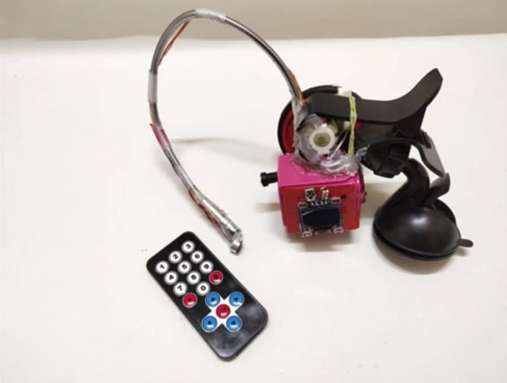
Key Features Whistle Detection: The device uses high-accuracy sensors or microphones to detect the sound of pressure cooker whistles, even in noisy kitchen environments. Whistle Counter: A built-in system counts the number of whistles and displays it in real-time on a digital screen. Users can set the desired count as per their recipe needs. Automatic Heat Switch-Off: When the preset whistle count is reached, the system automatically turns off the heat source, preventing overcooking and energy wastage. Compatibility with Cooktops: It works seamlessly with gas, induction, and electric cooktops, making it adaptable to various kitchen setups.

Slide 5
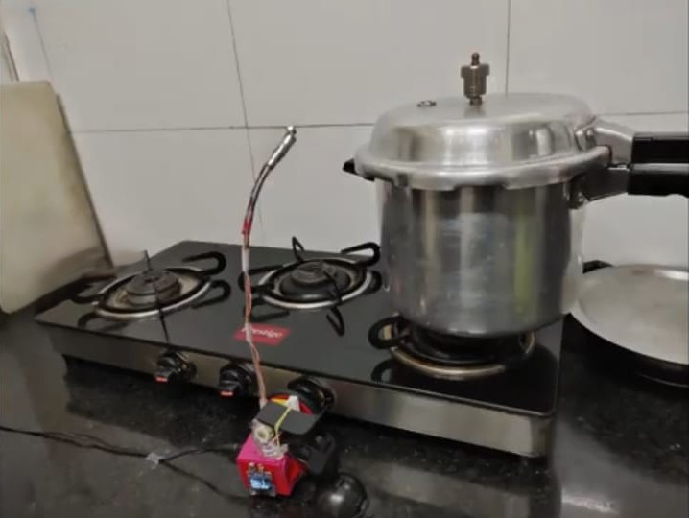
How It Works
Step 1: The user sets the required number of whistles based on the dish.
Step 2: Sensors detect the whistle sounds and count them in real-time.
Step 3: The system monitors the count and compares it with the preset value.
Step 4: Once the count is reached, the device automatically switches off the heat source.

Slide 6
Use Case Scenarios
Rice Cooking: Ensures perfectly cooked rice without undercooking or overcooking.
Lentils and Beans: Cooks lentils and beans to the right texture without breaking or overcooking.
Vegetable Curries: Maintains the desired consistency for curries by avoiding overboiling.
Benefits
Accurate Cooking Time:
Accurately cooks dishes with the exact count of whistles required for particular recipes.
Saving Energy and Time:
The product switches off the stove, conserving energy and freeing up the user for other activities without having to keep track of the cooking utensil.
Improved Safety:
Helps avoid accidents due to overheating and forgetting to turn off the stove to ensure safety in the kitchen.

Slide 7
Technology and Components
Sensors: For detecting whistles through sound or vibration.
Microcontroller: Processes the input from sensors and controls operations.
Digital Display: Shows the number of whistles in real-time and allows user input.
Switch-Off Mechanism: Automatically cuts off power or gas supply when cooking is complete.
Comparison with Traditional Cookers
Aspect | Traditional Cookers | Smart Cooker with Counter
Monitoring | Manual counting required | Automatic detection
Safety | Risk of overcooking | Automated switch-off
Energy Usage | Higher | Reduced
Convenience | Low | High

Slide 8
Market Potential and Demand Rising Demand: Increasing preference for smart kitchen appliances. Target Audience: Tech-savvy home cooks, working professionals, and families seeking convenience. Market Trends: Growing adoption of IoT-based smart devices in kitchens.
Future Improvements
IoT Integration: Control and monitor the device remotely using a smartphone app.
Voice Assistant Compatibility: Integration with virtual assistants like Alexa and Google Assistant.
Enhanced Battery Life: Improved power efficiency for wireless operations.
Customization Options: Allow users to save multiple whistle count presets for different dishes.

Slide 9
CONCLUSION
The Smart Cooker Whistle Counter with Automatic Switch-Off is a new game-changer in the world of cooking, bringing convenience, precision, and safety into the cooking process. The automation of whistle counting and controlling heat allows one to avoid the risk of overcooking and minimize energy wastage. With this product, busy households and individuals can be assured of a safer way of cooking in just less time and effort. With its user-friendly design and enhanced functionality, it is poised to revolutionize the way we cook, offering a perfect blend of technology and practicality for every kitchen.

Slide 10


